Slide 1
Modeling EHRs and genetics
Integrative Post-GWAS Methods: Advanced Statistics, Functional Genomics, and Machine Learning
Magnus Tvede Jungersen, Research Assistant
Simon Rasmussen, Professor
Novo Nordisk Foundation Center for Basic Metabolic Research
University of Copenhagen
August 26th, 2026, Aarhus University
Notes:
• Today I will connect longitudinal health records with transformer models and disease trajectories.
• I will keep the machine-learning details conceptual and focus on the biological questions.
• The aim is to see what EHR data adds beyond static genetic risk.

Slide 2

Agenda
Part 1: Electronic Health Record (EHR) data
Part 2: Transformer models
Part 3: Modeling EHR and genetics data
Notes:
• We will move from the structure of EHR data, to transformers, and then to current EHR-transformer applications.
• The examples are very recent, so this is an active and rapidly developing area.
• I will pause for short discussions at the transition points.

Slide 3
Part 1: EHR data and their use
Part 1: Longitudinal Electronic Health Record (EHR) data
What does EHR data add beyond DNA?
How are clinical events represented?
Why do order and timing matter?
How do sequences become disease trajectories?
Notes:
• Part 1 asks what EHR data contributes beyond DNA and how that information is organized over time.
• The key concept is that a patient record is not just a table—it is an ordered history of events.
• Keep the four questions on screen as signposts for this section.

Slide 4
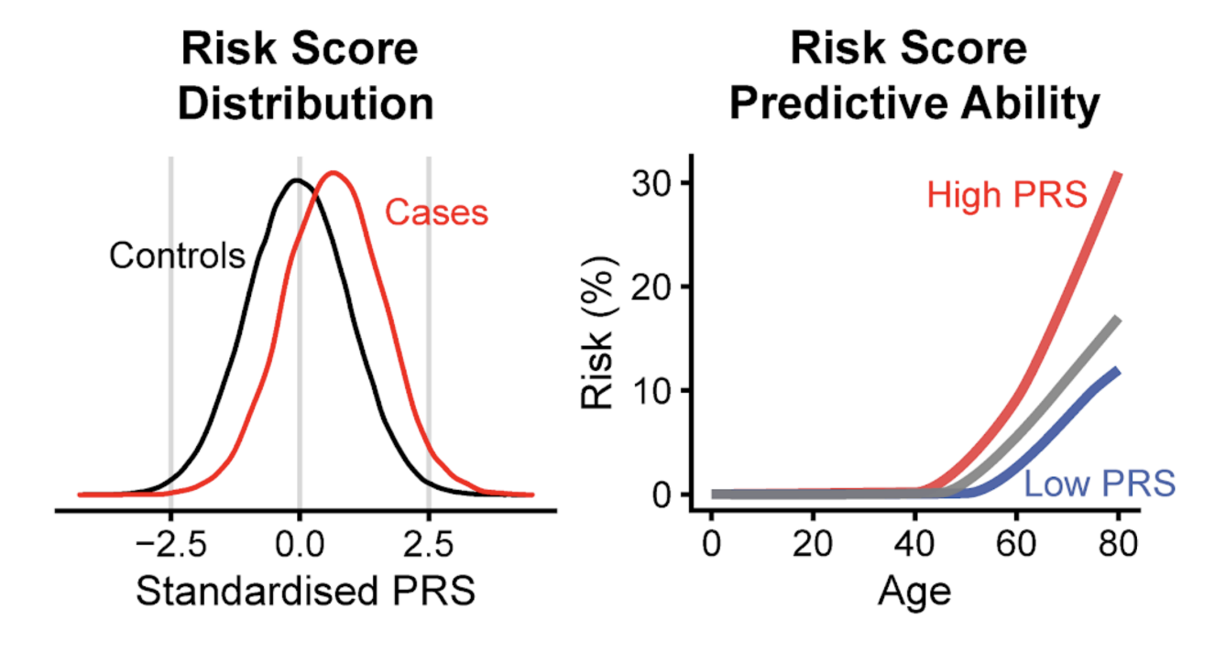
DNA is static and electronic health records are dynamic
Part 1: Longitudinal Electronic Health Record (EHR) data
DNA: a largely static baseline
• GWAS identifies associations
• PRS summarizes inherited risk
EHR: a dynamic trajectory
• Diagnoses, drugs, laboratory values, …
• Exposures and disease history
Notes:
• Germline DNA is largely fixed, so genetic models often describe a baseline or lifelong predisposition.
• EHR data accumulates: diagnoses, medications, laboratory values, and lifestyle-related measurements can change risk over time.
• The resulting trajectory can move from health, through early signals, to clinical disease.

Slide 5
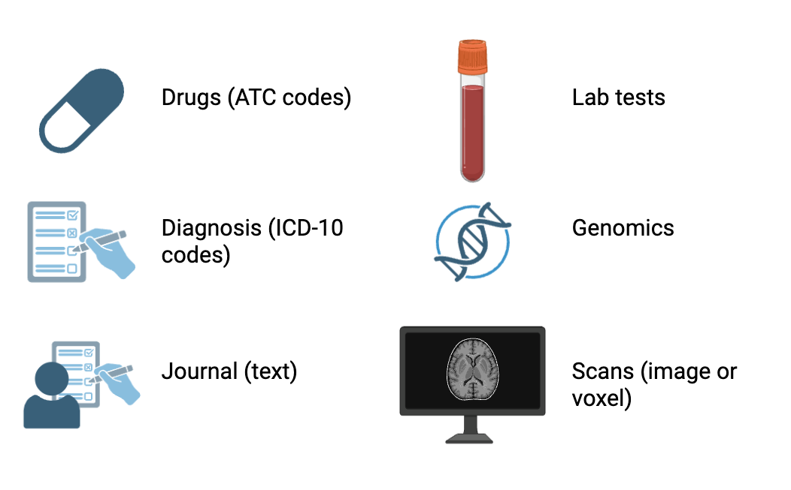
EHRs combine structured and unstructured modalities
Part 1: Longitudinal Electronic Health Record (EHR) data
Structured
• diagnoses and medications
• laboratory measurements
• genomics and lifestyle
Unstructured
• clinical notes
• images
Icons from BioRender
Notes:
• EHRs combine structured data—codes, measurements, drugs—with unstructured data such as notes and images.
• These modalities have different scales and formats, so they cannot simply be placed in one conventional analysis table.
• The modeling challenge is to create comparable representations without losing clinically relevant information.

Slide 6
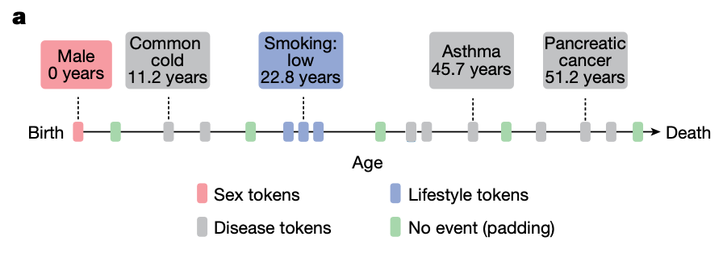
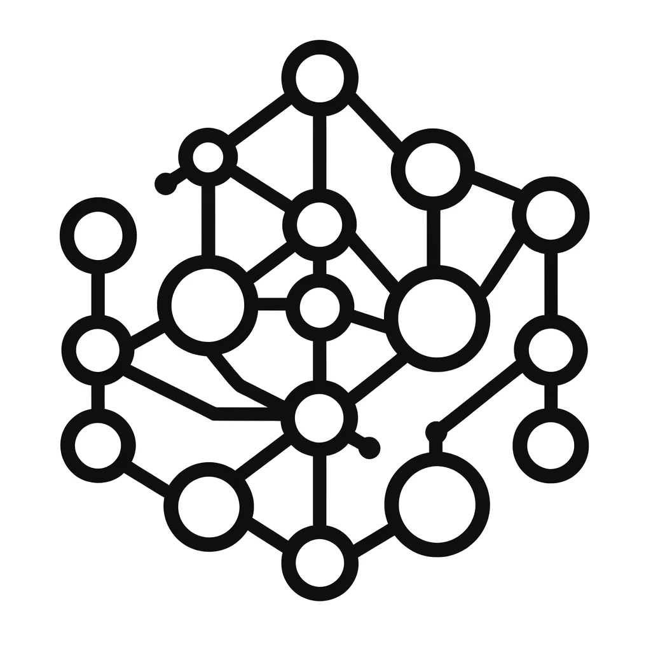
Sequential data adds a temporal dimension
Part 1: Longitudinal Electronic Health Record (EHR) data
A disease trajectory
Multiple types of data
Timing: A diagnosis at age 10 and 70 is different
Order of events: Diagnosis may lead to next
AI model
Notes:
• A single blood measurement is a snapshot; repeated measurements create a trajectory.
• Both order and elapsed time matter—for example, the same diagnosis at age 10 and age 70 has different context.
• Simultaneous events also need careful handling so the model does not learn an impossible order.
• Take home: EHR data is both multimodal and sequential.

Slide 7
From static genetic risk to dynamic patient representations
Part 1: Longitudinal Electronic Health Record (EHR) data
AI model
Dynamic patient representations
Genetic: static
EHR: dynamic and integrates previous history
Notes:
• A PRS compresses genetic information into a static risk estimate.
• An EHR model instead builds a patient representation that can be updated whenever new events occur.
• That representation can support next-event prediction or comparison with patients who followed similar trajectories.

Slide 8
Discussion: what does an EHR represent?
Q1. What can longitudinal EHR data capture that germline genetics cannot, and vice versa? Q2. What could be issues when transfering patient representation across hospitals or populations?
Notes:
Ask groups to choose two questions and separate biological information from healthcare-process information.
• Q1 cue: genetics captures inherited baseline risk; EHRs capture changing exposures, measurements, diagnoses, treatment, and care history.
• Q2 cue: visit frequency, coding, testing, and treatment reflect the health system as well as the patient.

Slide 9
Part 2: Transformer models
Part 2: Transformer Models
What is representation learning?
What is a transformer?
Why does attention suit sequential data?
How do tokens and embeddings turn biology into model inputs?
Notes:
• Part 2 introduces transformers at a conceptual level.
• We need three building blocks: tokens, embeddings, and attention.
• The goal is to understand why this architecture fits ordered, heterogeneous patient histories.

Slide 10
Autoencoders learn compressed representations
Type of neural network
Minimise difference between input and output (training)
Force the network to learn a latent representation
In
Out
1
Latent
1
5
5
3
3
2
2
1
1
4
4
0
0
Encoder
Decoder
Notes:
• Autoencoders learn without outcome labels by trying to reconstruct their input.
• The bottleneck prevents simple copying and forces a compressed latent representation.
• For EHRs, the hope is that this latent space captures clinically useful patient structure.

Slide 11
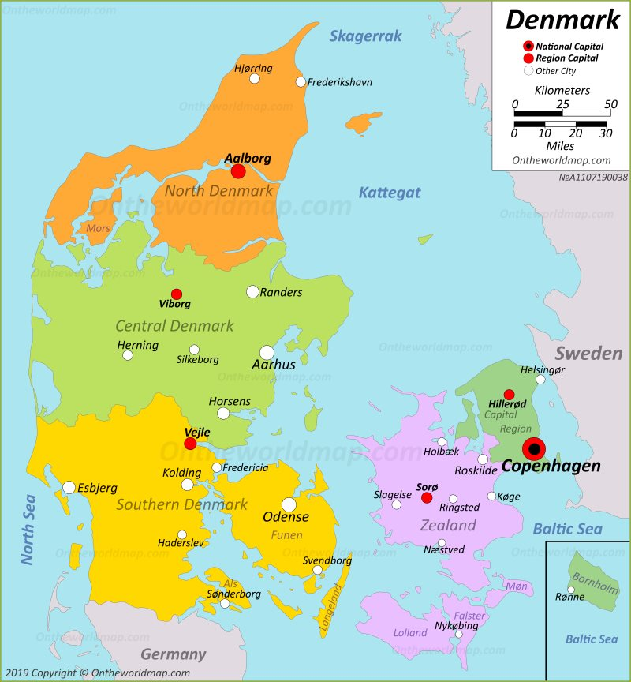
A useful representation preserves structure and removes detail
Learns structure
Focus on the important parts
For EHRs: compresses many events into an informative patient state
Notes:
• Use the map as an analogy: it preserves useful relationships while discarding most physical detail.
• A representation is task-dependent—the useful detail for navigation differs from the useful detail for disease prediction.
• In EHRs, we want a compact patient state that retains information relevant to the downstream question.

Slide 12
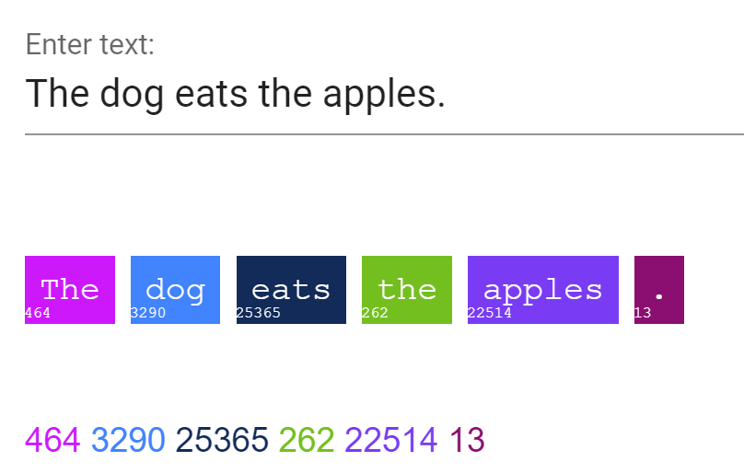
An EHR can be represented like a sentence
Part 2: Transformer Models
(‘Post-training methods for language models’ Eyceoz & Stevens)
(Shmatko et al. 2025)
Notes:
• Text is a sequence of tokens; an EHR can likewise be represented as a sequence of clinical events.
• A diagnosis, drug, or discretized laboratory result can act like a word in the model vocabulary.
• Unlike ordinary text, clinical events occur at irregular intervals, so time must be represented explicitly.

Slide 13
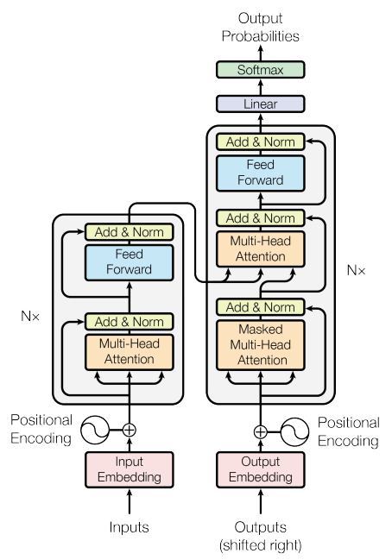
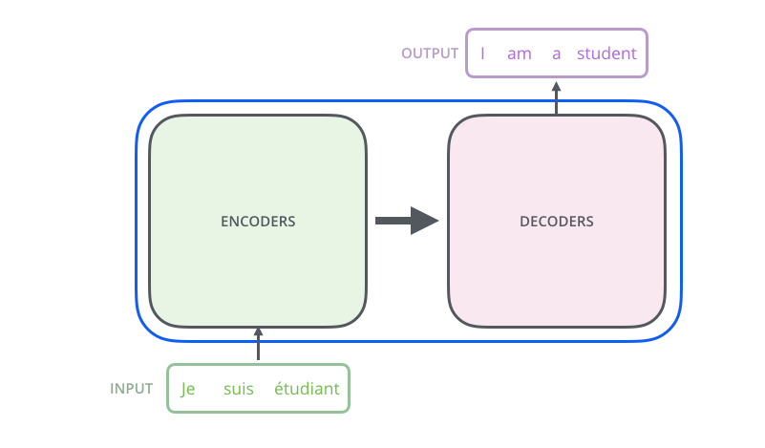
Transformers are state-of-the-art models for sequences
Decoder
Introduced for translation
Now used for text, DNA, proteins and EHRs
Encoder
(Vaswani et. al 2017)
Notes:
• Transformers were introduced for translation but now underpin many sequence models.
• The common idea is to learn context-dependent representations from ordered tokens.
• Biological sequences and patient histories use different vocabularies, but the modeling abstraction is similar.

Slide 14
Vocabulary and Tokenization
Part 2: Transformer Models
Vocabulary:
All the “words” that the model knows
Token:
Each “word” gets represented by a number
Notes:
• Transformers were introduced for language tasks, including translation and next-token prediction.
• In an EHR setting, the analogous task is to predict the next clinical event or diagnosis.
• The architecture is similar; the vocabulary and scientific interpretation are different.

Slide 15
Example EHR token sequence
Part 3: EHR-Transformer Models
Special tokens marks structure
Continous values are made into discrete values (because the model only understands tokens)
MALE
[VISIT_START] AGE_59 LAB_HDL_cholesterol_92% LAB_LDL_Cholesterol_84% LAB_Total_Triglycerides_22% DX_I25 [VISIT_END]
[SEP]
[VISIT_START] AGE_60 LAB_HDL_cholesterol_94% LAB_LDL_Cholesterol_96% LAB_Total_Triglycerides_24% DX_I25 [VISIT_END]
[SEP]
[VISIT_START] AGE_62 LAB_HDL_cholesterol_98% LAB_LDL_Cholesterol_98% LAB_Total_Triglycerides_30% DX_I25 [VISIT_END]
Notes:
• Special tokens mark structure that is not itself a diagnosis—for example, the start and end of a visit.
• Age tokens and separators preserve temporal and encounter-level organization.
• Laboratory values are discretized here, turning continuous measurements into vocabulary items.

Slide 16
Encoder and decoder models optimize different objectives
Part 2: Transformer Models
Decoder
Encoder-only (BERT)
reconstruct masked tokens
Encoder
Decoder-only (GPT):
predict the next token
(Vaswani et. al 2017)
Notes:
• Encoder-style models learn representations from surrounding context, often by masking tokens.
• Decoder-style models predict the next token from the preceding sequence.
• For EHRs, choose the objective to match the question: patient representation versus future-event generation.

Slide 17
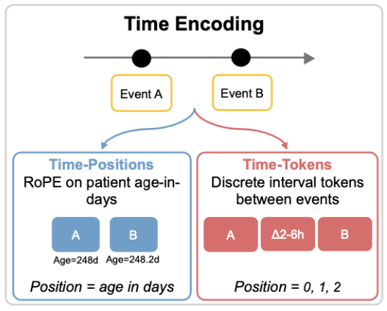
Transformers need positional information to represent order
The model does not know token order
Positional embeddings add:
Order
Time between events
Notes:
• Attention compares tokens, but token order must be supplied separately.
• Positional embeddings add an order signal to each token representation.
• For EHR data, absolute position may be less useful than age, time gaps, and visit boundaries.

Slide 18
Attention identifies which earlier events are relevant
Part 2: Transformer Models
Attention
Self attention: clues that can help lead to a better encoding for this word
”Which tokens are important here”
Notes:
• Attention asks which other tokens are relevant when updating the current token representation.
• In an EHR, the relevant context might include earlier diagnoses, drugs, laboratory results, or comorbidities.
• Attention is context-dependent association; it is not proof of a biological mechanism or causal effect.

Slide 19
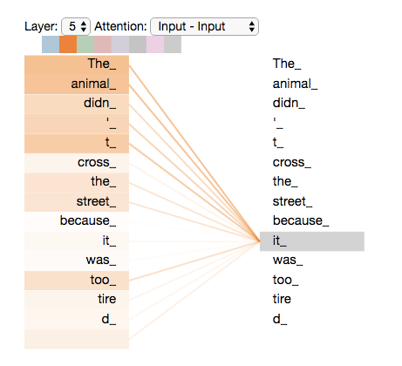
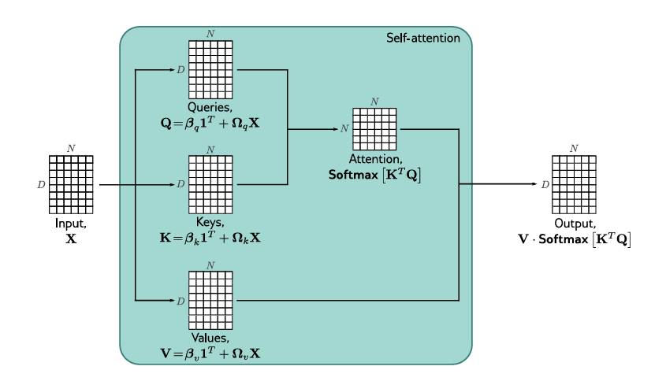
Attention compares each event with its relevant history
Part 2: Transformer Models
Conceptually:
• compare events
• weight relevant context
• update the representation
(‘Understanding Deep Learning’ by Simon J. D. Prince)
(‘The Illustrated Transformer’ blogpost by Jay Alammar)
Notes:
What does “it” in this sentence refer to? Is it referring to the street or to the animal? It’s a simple question to a human, but not as simple to an algorithm.
• Attention compares each token with other tokens and assigns greater weight to the most relevant context.
• In a patient record, a current event may attend to earlier diagnoses, medications, or measurements.
• The matrix mathematics is substantial; for this audience, the conceptual message is enough.

Slide 20
Take-home messages: building a transformer input
Part 2: Transformer Models
• Vocabulary: which events the model can recognize • Tokens: numerical IDs for those events • Embeddings: learned vector representations • Position/time: where and when events occur • Attention: which context is relevant
Choose the model to match the task:
Representation learning (BERT) or next-event prediction (GPT)
Notes:
• Recap the pipeline: vocabulary → token IDs → embeddings → position/time information → attention.
• Encoder objectives are useful for representation learning; decoder objectives are useful for forecasting or simulation.
• The appropriate architecture depends on the scientific question and evaluation target.

Slide 21
Discussion: design choices for an EHR transformer
Q1. When would you choose an encoder (BERT) versus a decoder (GPT) for EHR data? Q2. How can the model distinguish events on the same day from events five years apart? Q3. What is lost when laboratory values (numbers) become tokens?
Q4. What does high attention to an earlier diagnosis tell us - and what does it not?
Notes:
• Q1 cue: masked-token or encoder objectives support patient representations; decoder objectives support next-event generation.
• Q2 cue: combine visit markers with age, elapsed-time, or continuous time encodings.
• Q3 cue: discretization simplifies the vocabulary but loses resolution and makes thresholds and units important.
• Q4 cue: attention shows model relevance in context; it does not establish causality, mechanism, or clinical validity.

Slide 22
Part 3: Using transformers to model EHR and genetics
Part 3: EHR-Transformer Models
From EHR sequence models to application:
Predict future clinical events
Simulate possible disease trajectories
Identify patterns in co-morbidities
Integrate genetics data
Notes:
• Part 3 applies the earlier concepts to real EHR-transformer models.
• We will look at multimodal tokenization, disease prediction, simulated trajectories, and integration of genetics.
• Keep asking whether each result is predictive, descriptive, or genuinely causal.

Slide 23
GPT: Next-token probability is conditional disease risk
Part 3: EHR-Transformer Models
Repeat:
Model has to guess the next token
It chooses from all possible tokens
For EHRs:
What is the next disease?
(‘Post-training methods for language models’ Eyceoz & Stevens)
Notes:
• In language models, the output is a probability distribution over the next word.
• In an EHR model, the output can be probabilities for the next diagnosis or clinical event.
• Those probabilities can be interpreted as conditional risk given the recorded history.

Slide 24
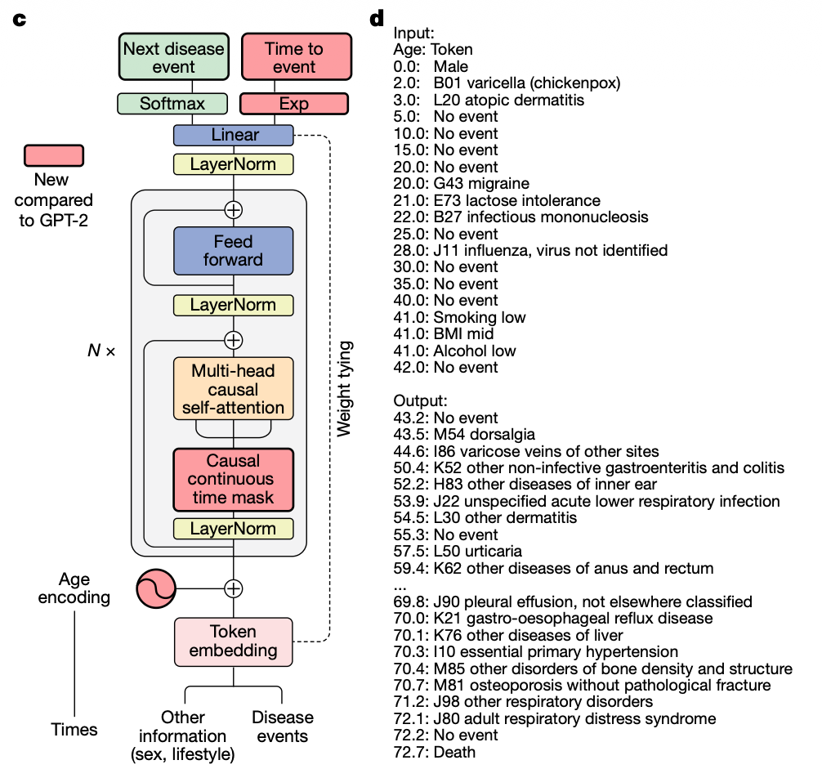
DELPHI model: GPT-style health transformer
Part 3: EHR-Transformer Models
Decoder-only model (GPT)
Predicts next disease event
Predicts time to the next event
(Shmatko et al. 2025)
Notes:
• Healthcare sequences require more than event identity: age and time between events are biologically important.
• DELPHI uses a GPT-style architecture and conditions predictions on prior events.
• A causal mask prevents the model from seeing future information during training.
• Events recorded at the same time need special handling to avoid artificial ordering.

Slide 25
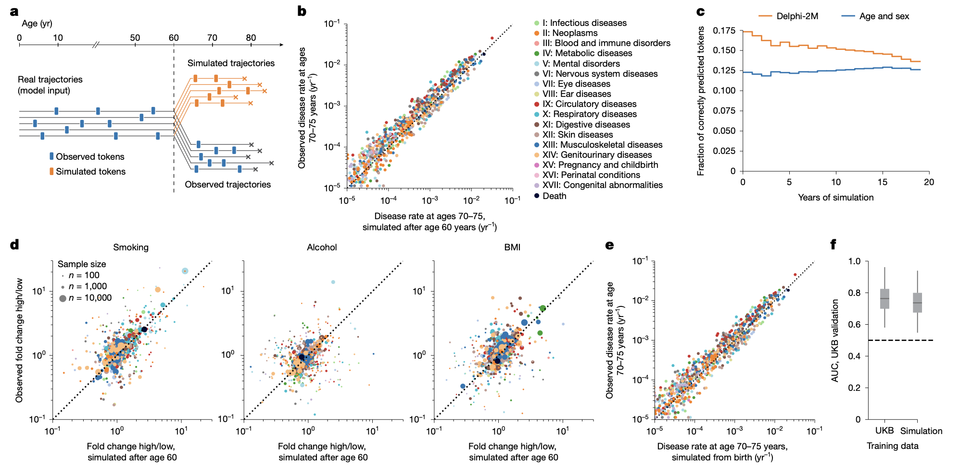
Autoregressive sampling generates multiple possible trajectories
Part 3: EHR-Transformer Models
We can ask questions about patient future!
(Shmatko et al. 2025)
Notes:
• Autoregressive prediction can be repeated to generate an entire possible future trajectory.
• Sampling several times gives multiple plausible futures for the same starting history.
• These are model-generated scenarios, not certain forecasts for an individual patient.

Slide 26
Calibration asks whether predicted rates match observed rates
Part 3: EHR-Transformer Models
Patient future
Population disease risk
Sample multiple possible futures from each patient history
Compare predicted and observed rates by disease and age
(Shmatko et al. 2025)

Slide 27
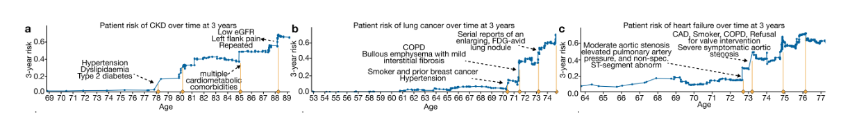
Comorbidities update future disease risk
Part 3: EHR-Transformer Models
Chronic Kidney Disease
Disease trajectories
New events update the model’s estimate of what happen next
Risk is dynamic – not a fixed patient score (genetics)
Heart Failure
(Shmatko et al. 2025)
Notes:
• New diagnoses and medications update the model’s estimate of what may happen next.
• Comorbidities matter because diseases do not occur independently.
• Use the examples to show risk changing over time rather than remaining a single fixed number.

Slide 28
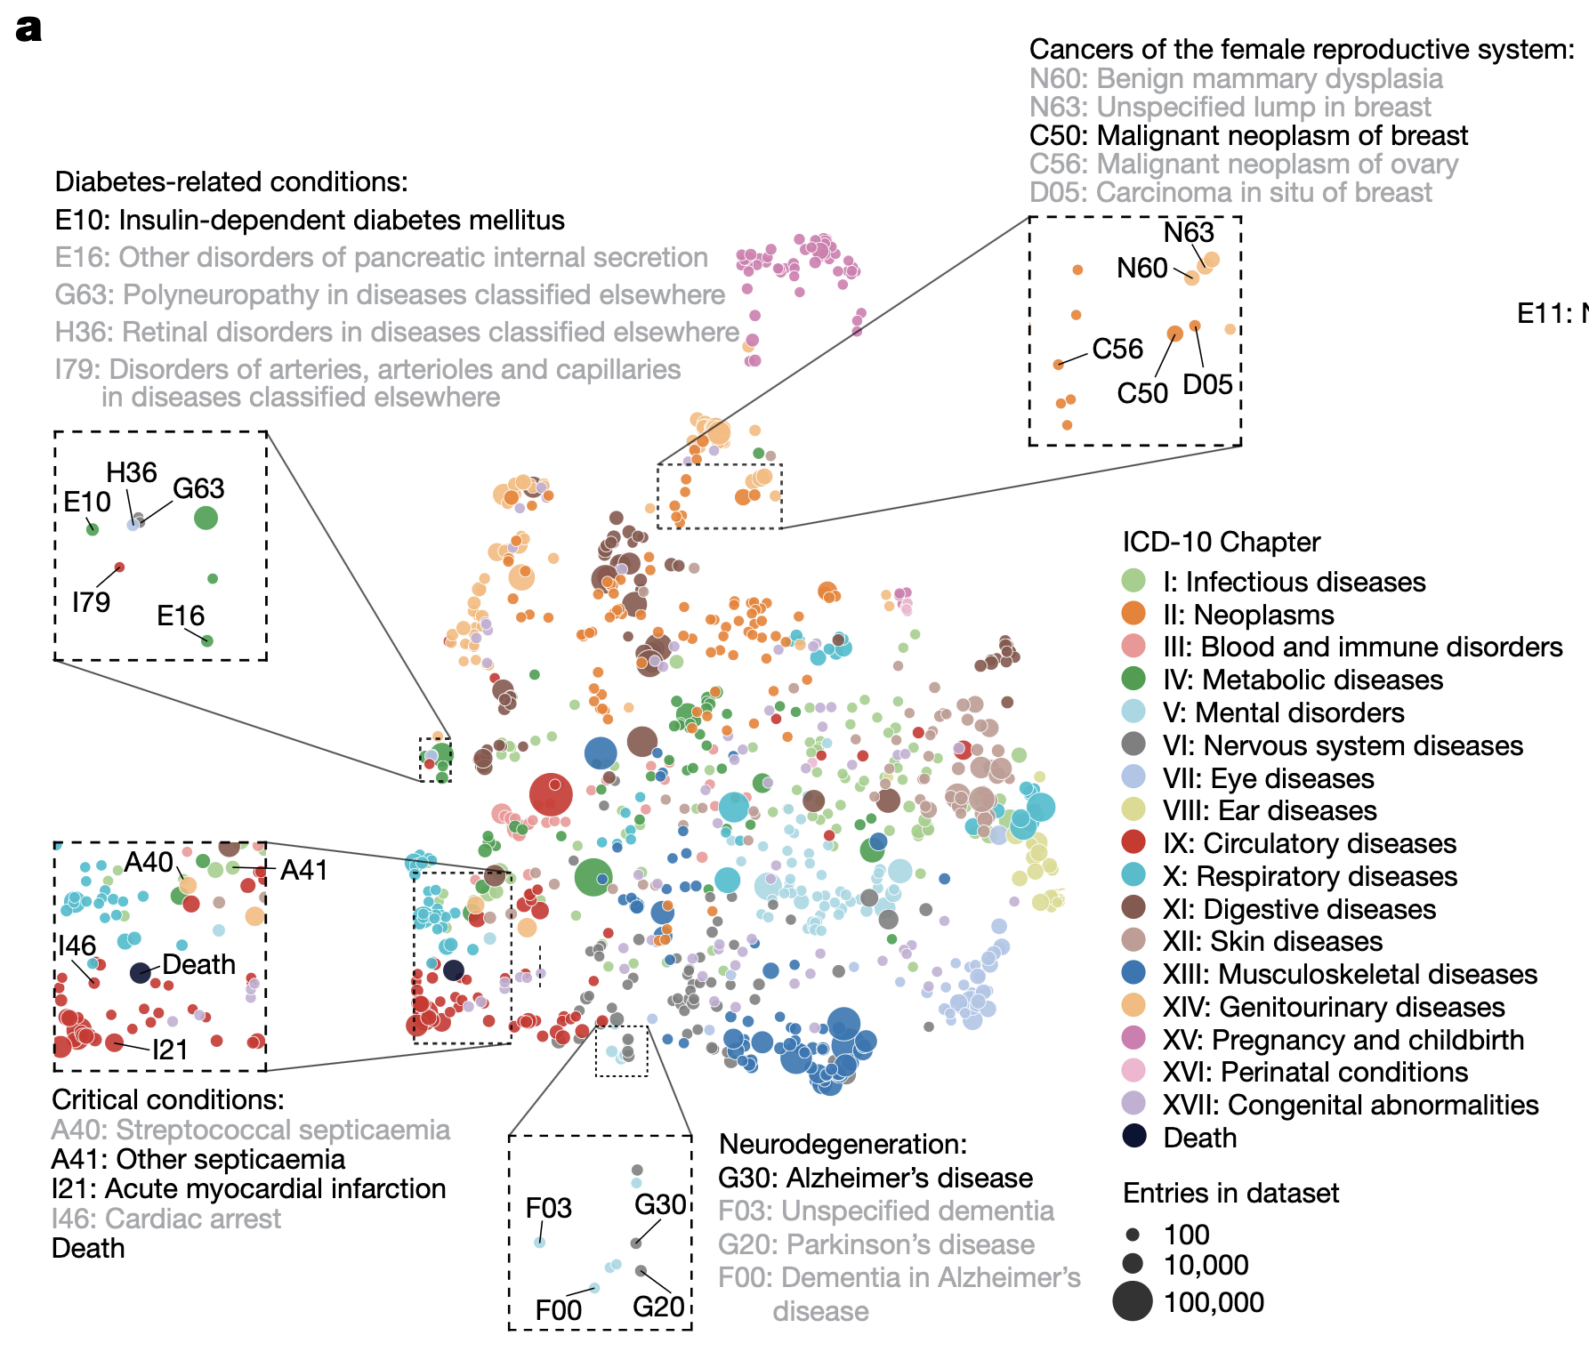
Embedding space groups diagnoses by learned context
Part 3: EHR-Transformer Models
Disease embedding space from trajectories
Completely unsupervised
Model learns disease similarity
Notes:
• This visualization projects a high-dimensional embedding space into two dimensions.
• Nearby points represent diagnoses with similar learned vectors, not necessarily the same biological mechanism.
• Use broad clusters as a qualitative check; avoid over-interpreting exact distances in a 2D projection.

Slide 29
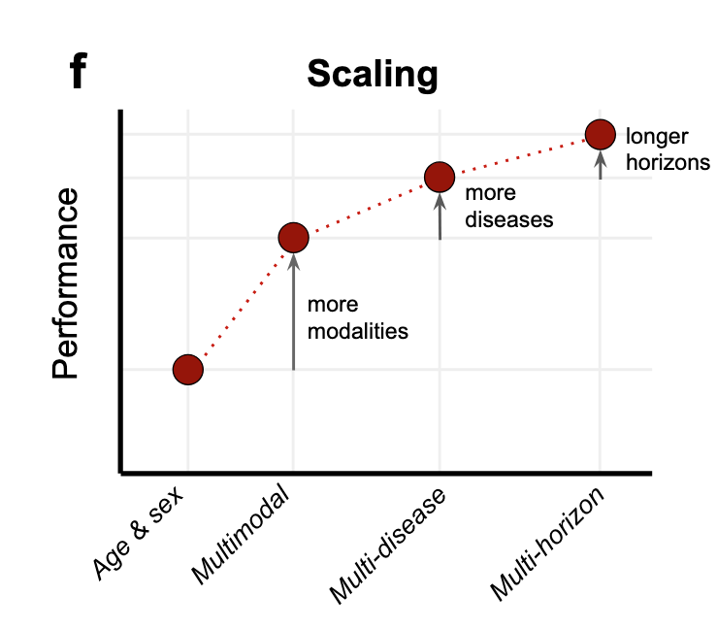
Performance: Depends on disease and horizon
Part 3: EHR-Transformer Models
Performance depends on:
• available modalities
• outcome prevalence and complexity
• prediction horizon
• cohort size and follow-up
(Hager et. al 2026)
Notes:
• Optional if time is short.
• More modalities and more data can improve performance, but gains vary by disease and prediction horizon.
• Rare outcomes, missing measurements, and limited follow-up remain important constraints.

Slide 30
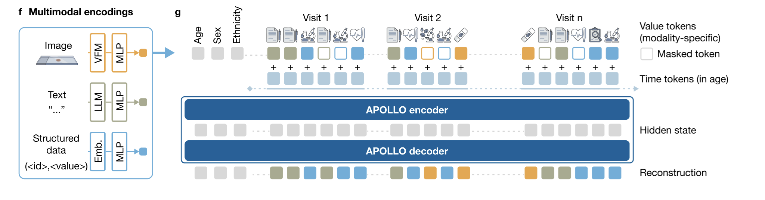
Multiple modalities can be modeled
Part 3: EHR-Transformer Models
≈230,000 clinical tokens → shared 768-dimensional embeddings
(Zhang et. al 2026)
Notes:
• Each modality is converted into a vector of the same size before entering the transformer.
• Diagnoses, medications, laboratory bins, text, and images may use different preprocessing or smaller encoders.
• A shared embedding dimension lets the transformer process them in one sequence.
• Standardizing dimensions does not make the underlying data equally reliable.

Slide 31
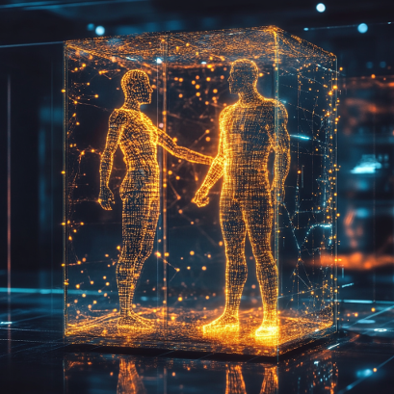
Can we add genetics into this?
Possible representations
PRS tokens
Gene-level burden scores
Genomic embeddings (EIR-FM)
Key challenges
Dimensionality and scale
Ancestry bias
Interpretability
Notes:
• Ask how genomics could enter a continuously updated patient representation.
• Possible answers include PRS tokens, gene-level burden scores, or a separate genomic encoder.
• Ask what must be solved: dimensionality, ancestry bias, scale mismatch, missingness, and interpretability.
• Allow about five minutes for discussion.

Slide 32
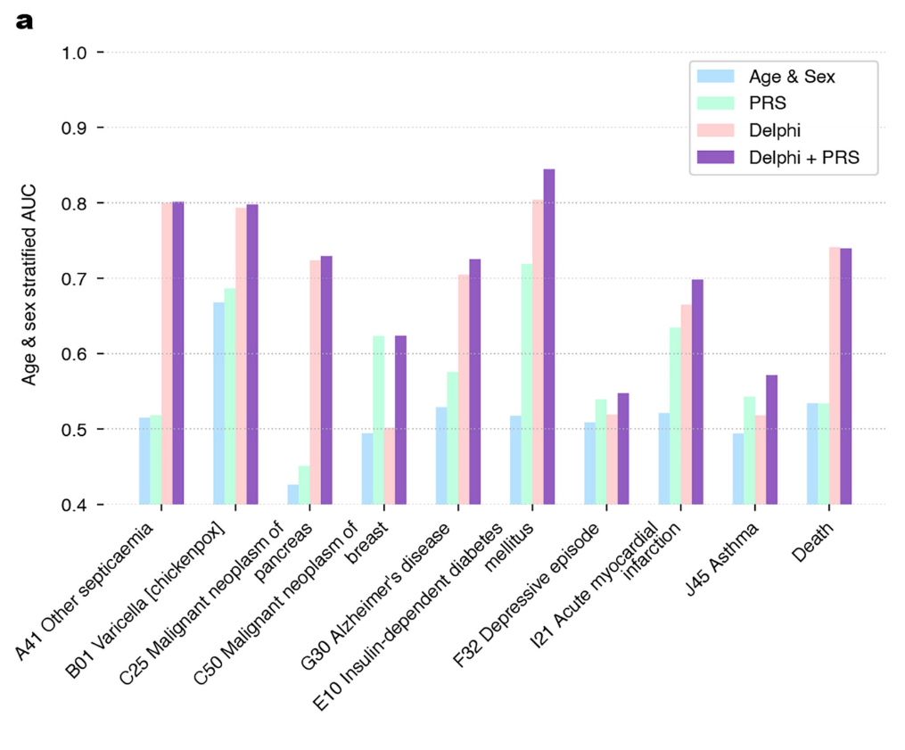
PRS and biomarkers add complementary predictive information
Part 3: EHR-Transformer Models
PRS can add information
Combining PRS with EHR data
Just another token(s)!
Can improve prediction of certain outcomes
(Shmatko et al. 2025)
Notes:
• DELPHI already uses diagnoses and selected demographic and lifestyle variables.
• Adding PRS or biomarkers provides information not fully captured by the EHR history.
• The incremental gain asks whether each modality adds predictive value beyond age, sex, and model logits.
• Focus on effect size and validation, not only statistical significance.

Slide 33
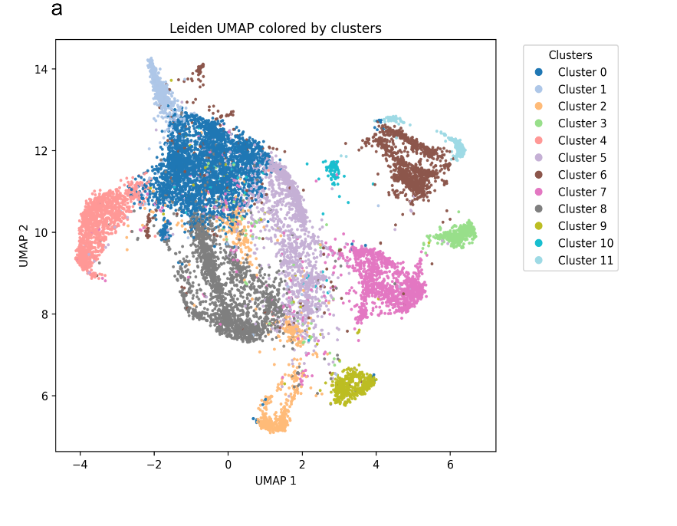
EHRs as targets for GWAS: ADHD
All of Us dataset (US)
ADHD
13,000 individuals with ADHD
Both EHR and genetics
EIR-GPT on EHR -> patient digital twins -> targets for GWAS!
Work in progress
Lisa Thunegaard, Jiyeon Min

Slide 34
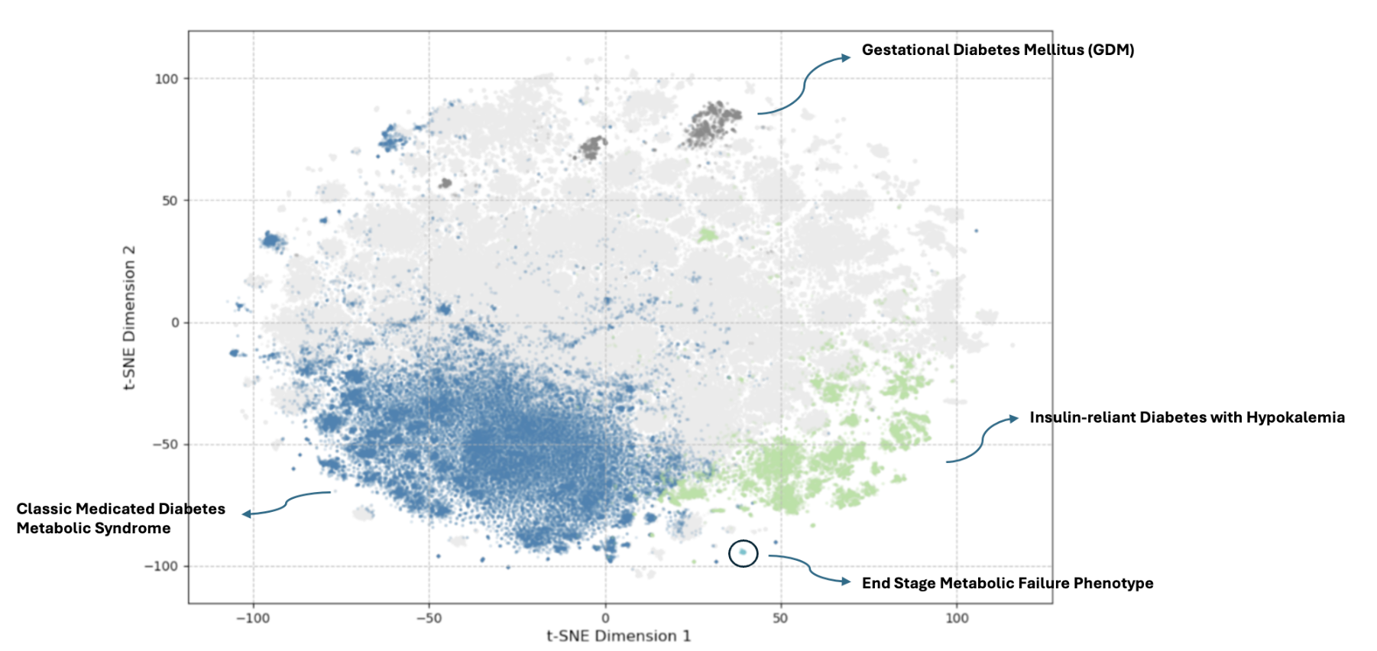
EHRs as targets for GWAS: Cardiometabolic disease
All of Us dataset (US)
Cardiometabolic diseases
EHR: Medication only
300,000 individuals
Work in progress
Konstantinos Gkagkaridis

Slide 35
Discussion part 3:
Part 3: EHR-Transformer Models
Q1: What is captured by EHR and what is captured by genetics?
Q2: When might genetics or biomarkers add value beyond EHR history, and how would you test it?

Slide 36
Summary
• EHRs are multimodal sequences, not static tables
• Tokens, embeddings and attention represent event identity, timing and context
• Transformers can predict and simulate trajectories
• We can integrate genetics or use EHR trajectories as targets for GWAS
Notes:
• First take-home: EHRs are multimodal sequences, not static tables.
• Second: transformers can represent event identity, order, timing, and context through tokens, embeddings, and attention.
• Third: these models can predict and simulate trajectories, but prediction must not be confused with causation.
• Genomics and biomarkers can add complementary information.

Slide 37
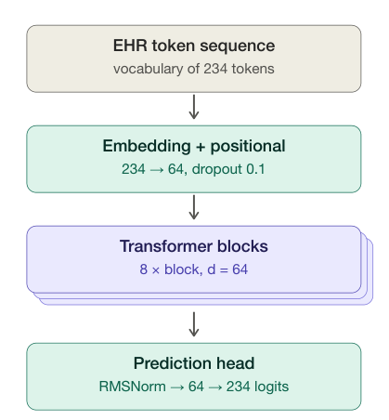
Exercise: build and evaluate an EHR transformer
We will
Simulate and tokenize longitudinal EHR trajectories Use a GPT-style model to predict the next token Generate many possible futures and compare them with observed historie Add genetic risk scores and explore patient representations
Notes:
• The exercise uses simulated data, so focus on understanding the representation rather than clinical conclusions.
• The 234 logits correspond to the model’s possible output classes or vocabulary items for the prediction task.
• Walk through the sequence: sex, visit boundaries, age, binned laboratory values, diagnosis, then a separator.
• Percentile-like bins do not need to sum to 100 because each laboratory variable is encoded separately.

Slide 38
Appendix

Slide 39
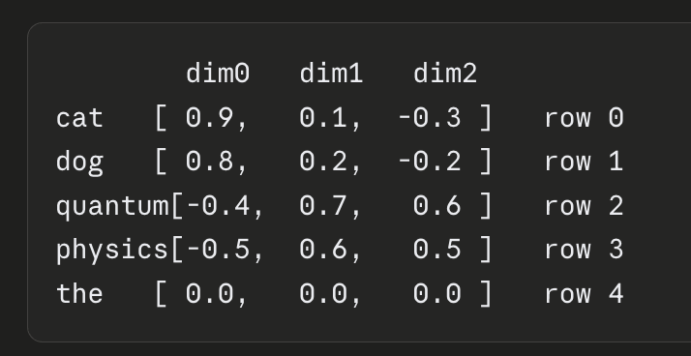
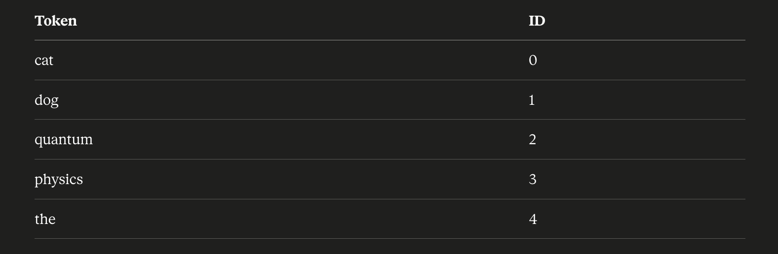
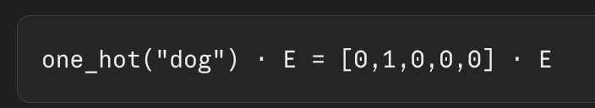
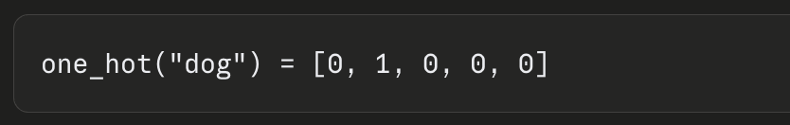
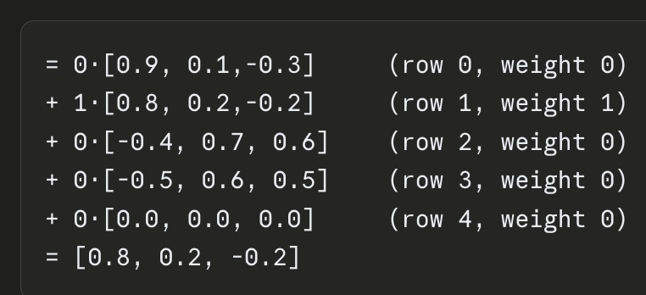
Embeddings turn tokens into learned numerical representations
Part 2: Transformer Models
Embeddings
Vocabulary
One-hot encoding
Vocabulary size: 200.000
Embedding size 4000
Example generated by Claude
Notes:
• The vocabulary lists the events the model can recognize.
• One-hot encoding only labels tokens; embeddings give each token a learned vector representation.
• During training, related tokens can move closer in embedding space—for example, related diagnoses may acquire similar vectors.
• The dimensions themselves are not directly named biological features.

Slide 40
Key open questions
Part 3: EHR-Transformer Models
• Which modalities add signal rather than noise?
• Which architecture best matches the scientific task?
• How should dense wearable data be summarized?
• How do we scale to millions of variants and events?
Notes:
• More data is not automatically better; every modality adds noise, missingness, cost, and potential bias.
• Architecture choice should follow the scientific task, not current popularity.
• Wearables add dense time series that may require summarization or dedicated encoders.
• Scaling to millions of variants and continuous sensor data remains a major computational challenge.

